Slide 1
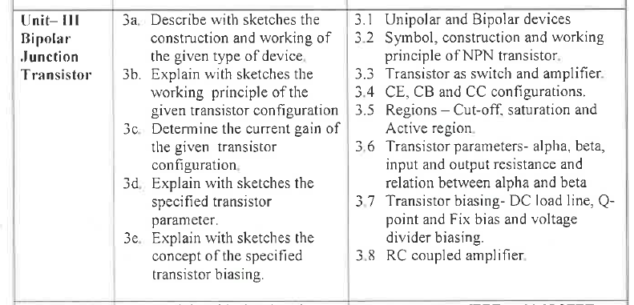

Slide 2
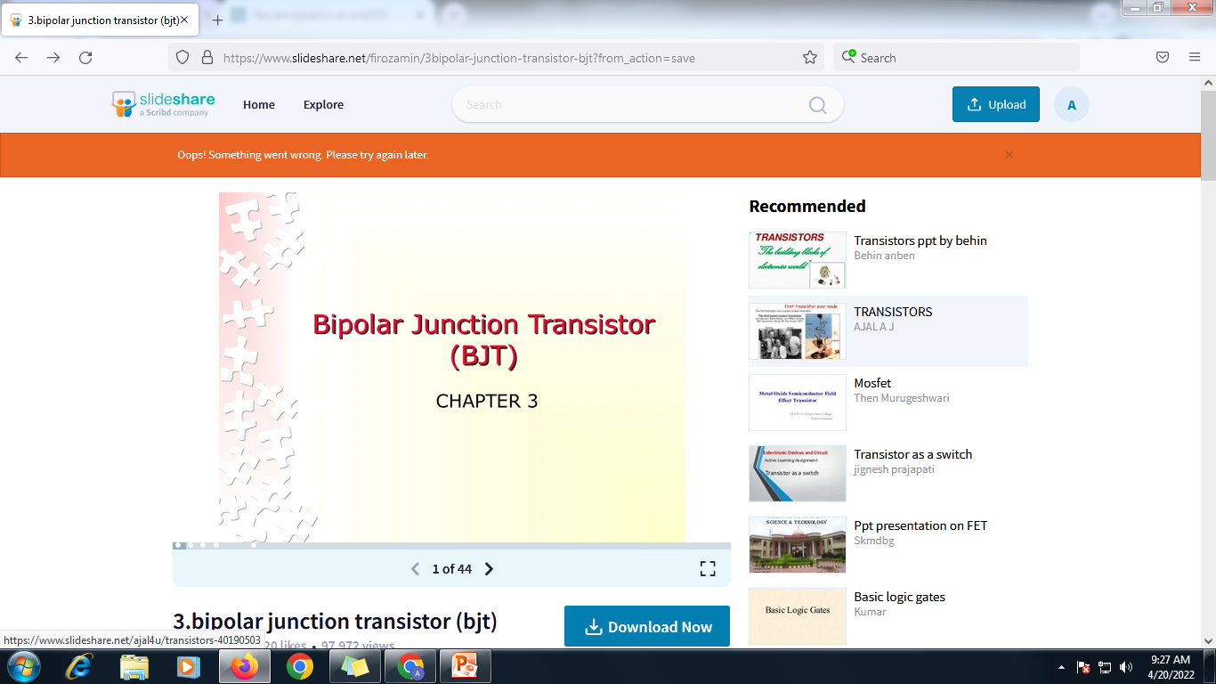
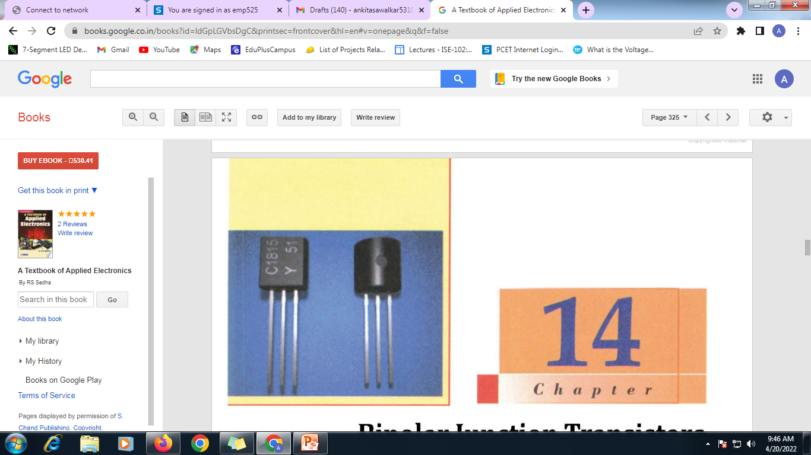

Slide 3
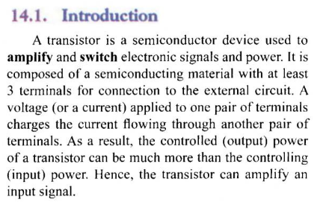

Slide 4
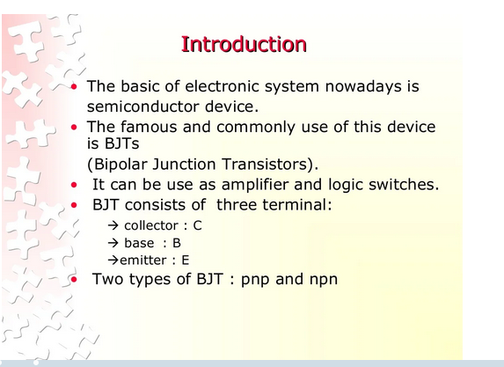

Slide 5
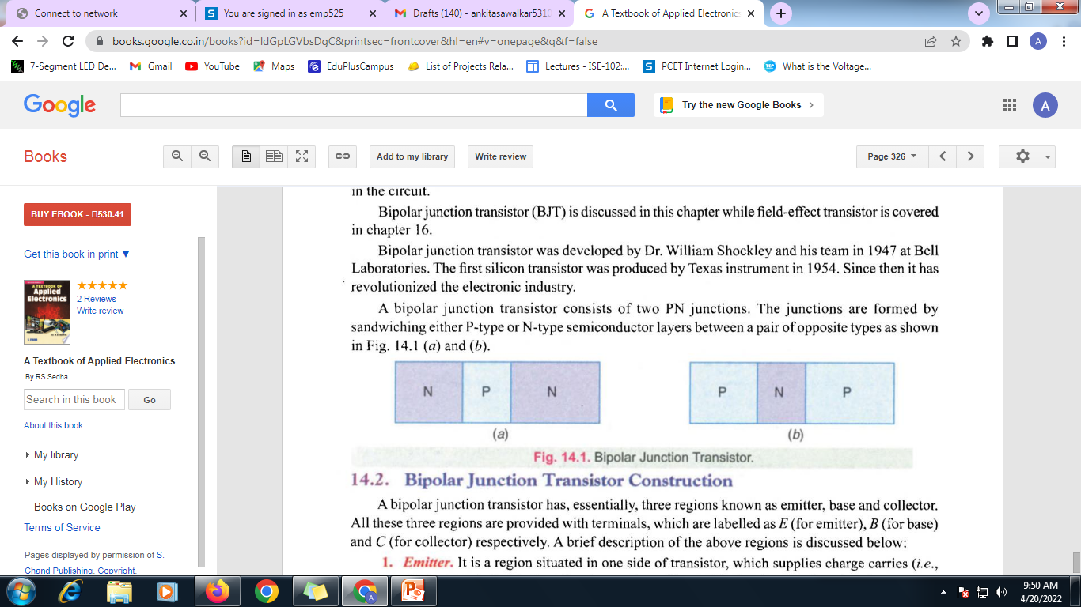

Slide 6
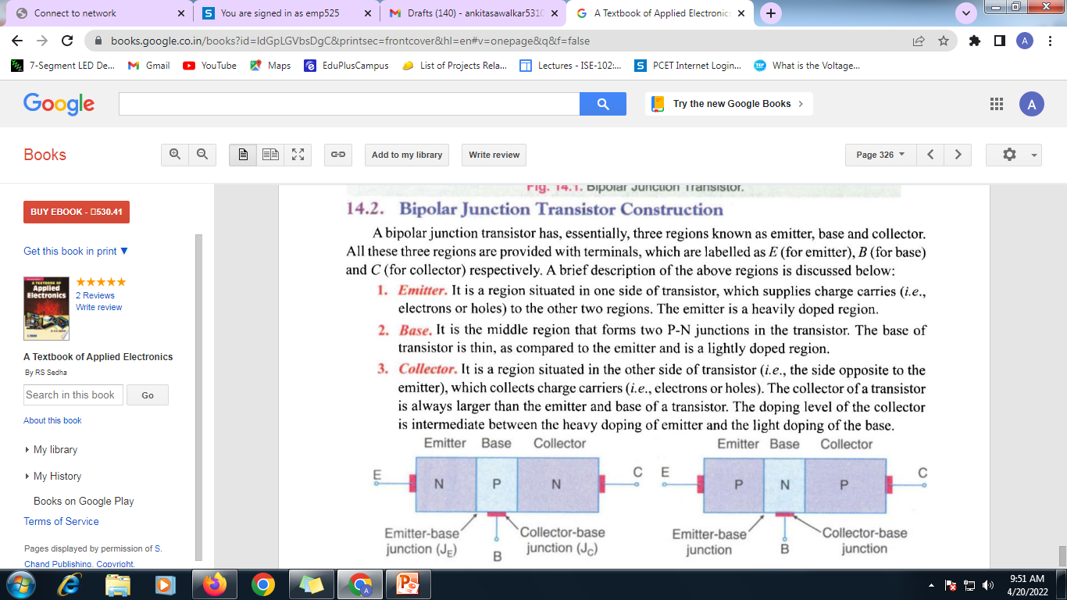

Slide 7
Biasing conditions for different regions of operation
Sr. No | Region of operation | Base emitter junction | Collector base junction | Application
1 | Cutoff region | Reverse biased | Reverse biased | Open Switch
2 | Forward active region | Forward biased | Reverse biased | Amplifier
3 | Saturation Region | Forward biased | Forward biased | Closed Switch
4 | Inverse Active | Reverse biased | Forward biased

Slide 8
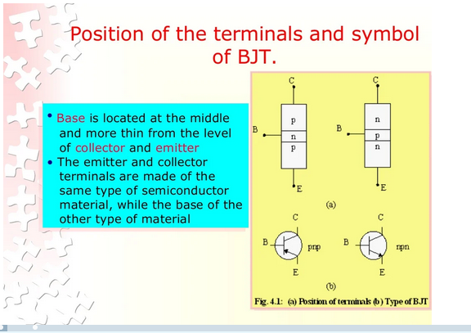

Slide 9
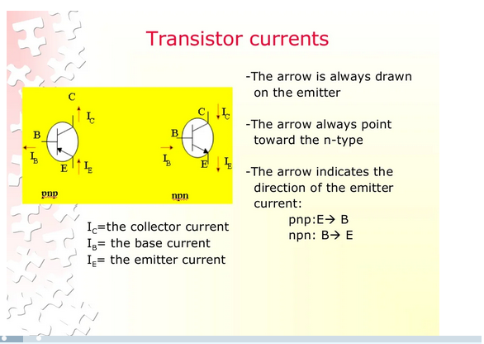

Slide 10
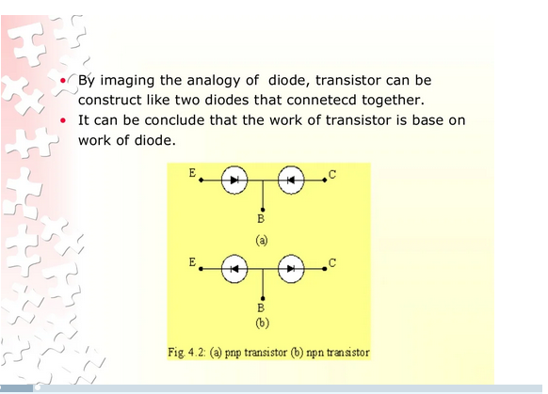

Slide 11
Transistor Biasing in the Active Region:
Biasing is the process of applying external voltages to the transistor. The two junctions in a BJT must be biased properly in order to operate it as an amplifier. A transistor cannot work unless external DC power supplies are connected to it.
A BJT is capable of operating in four different regions, depending on the way in which it is biased. The regions of operation are:
1. Cutoff region (transistor is OFF)
2. Saturation region (transistor is fully ON)
3. Forward active region (in between saturation and cutoff).
4. Inverse active mode

Slide 12
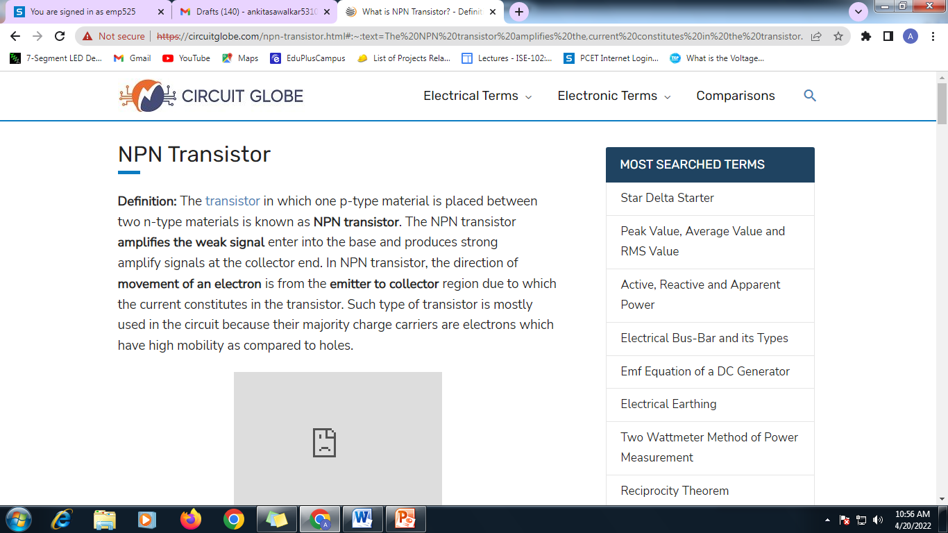

Slide 13
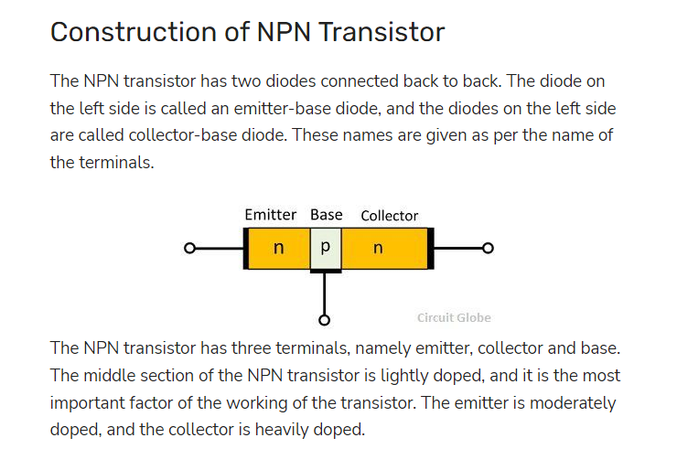

Slide 14
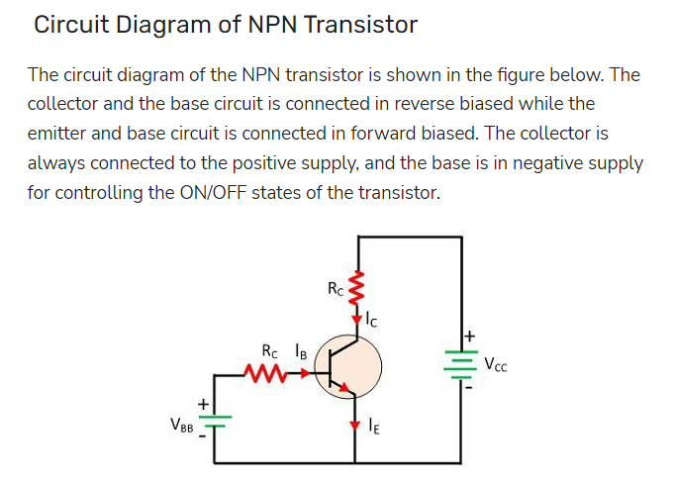

Slide 15
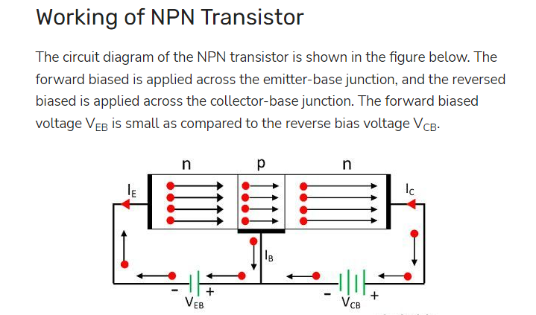

Slide 16
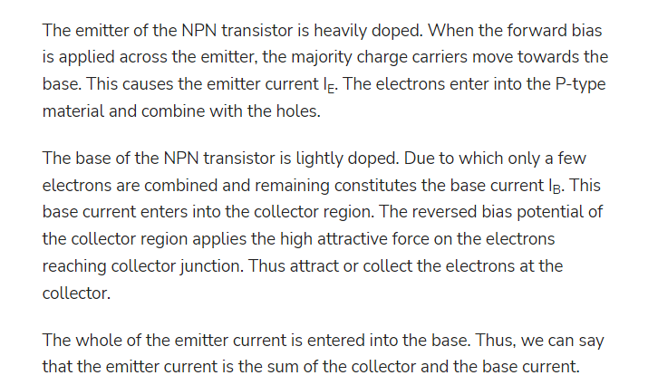

Slide 17
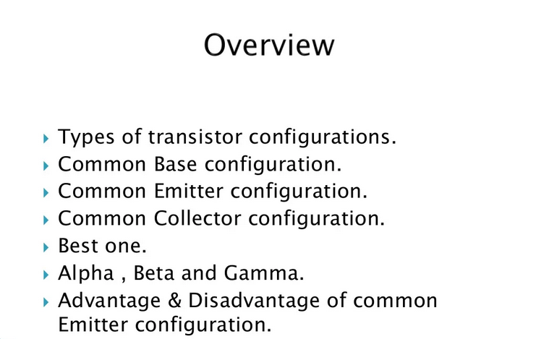

Slide 18
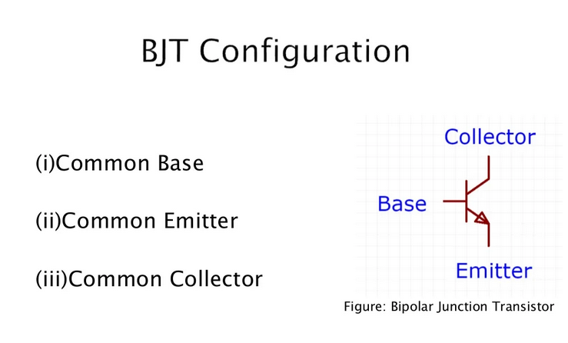

Slide 19
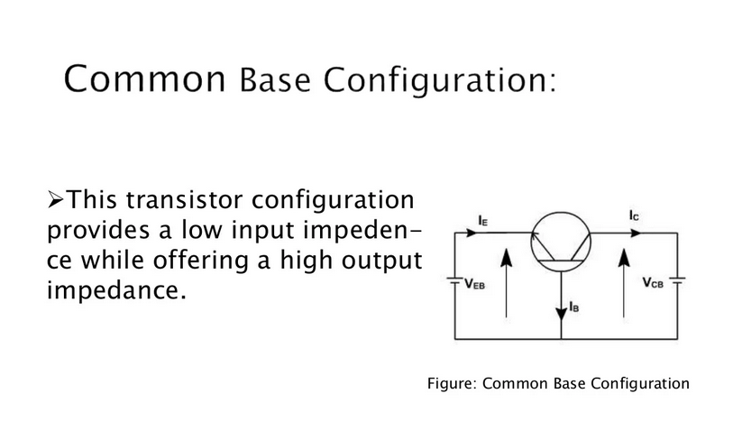

Slide 20
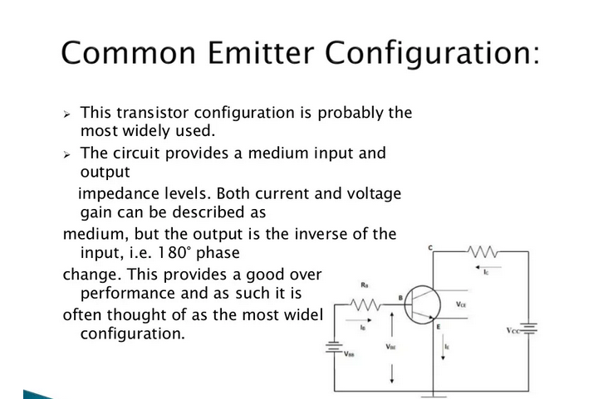

Slide 21
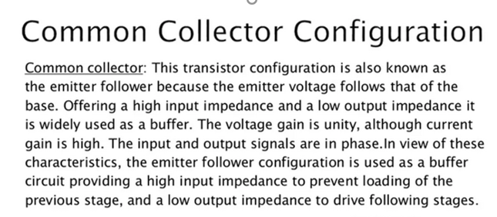
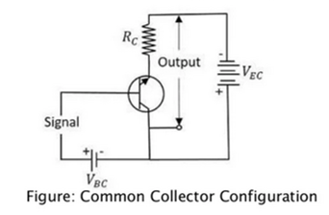

Slide 22
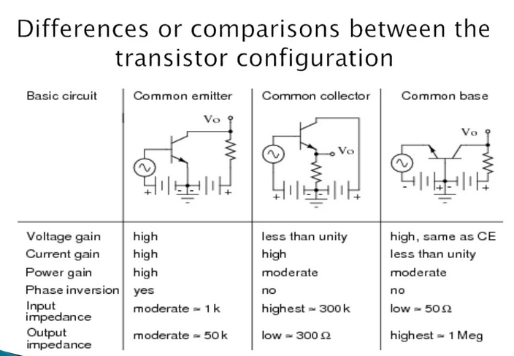

Slide 23
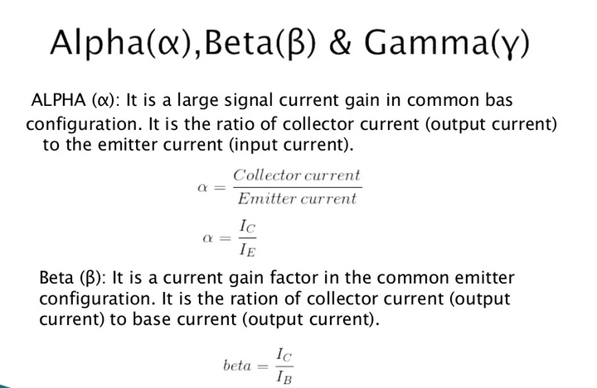

Slide 24
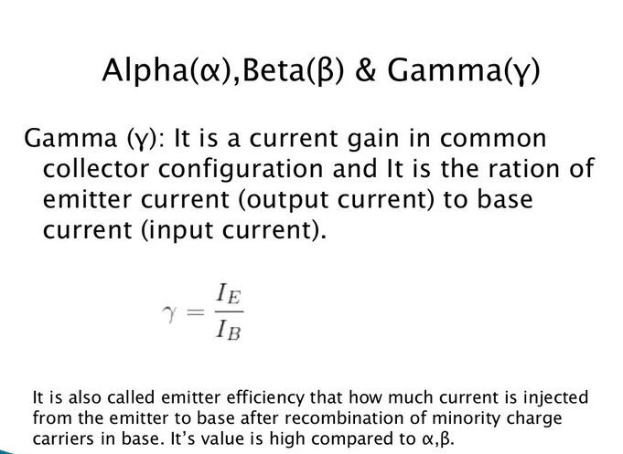

Slide 25
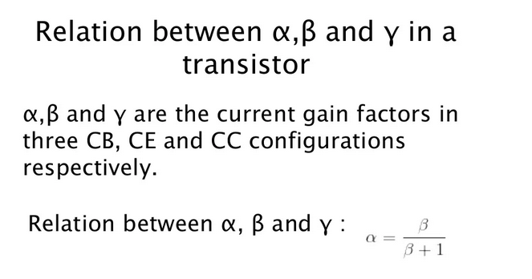
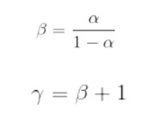

Slide 26
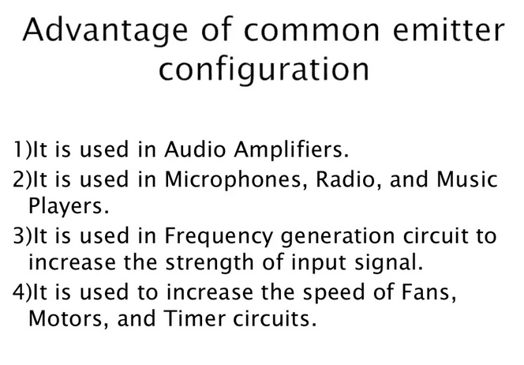

Slide 27
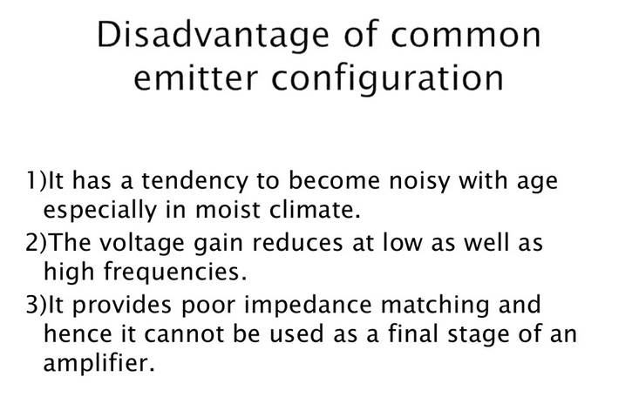

Slide 28
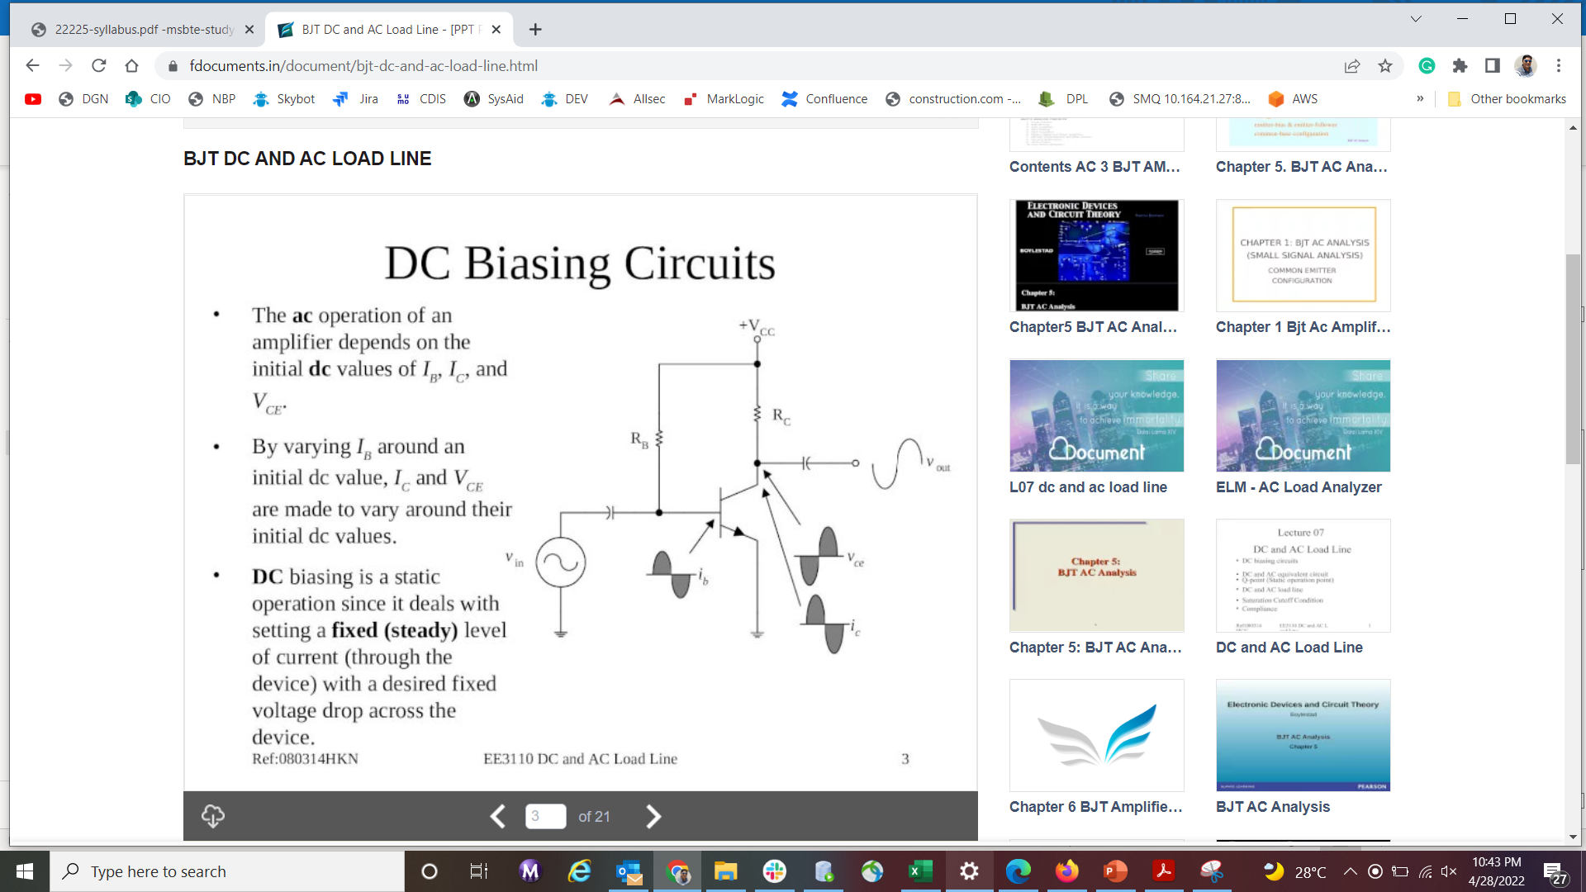

Slide 29
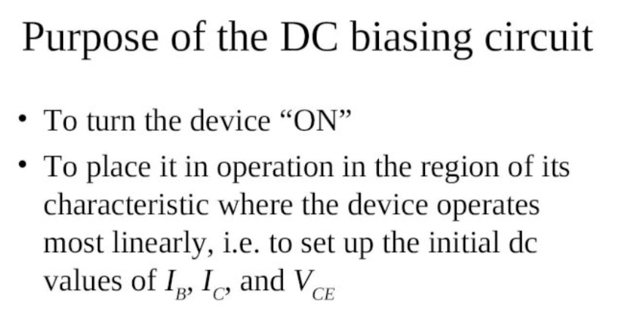

Slide 30
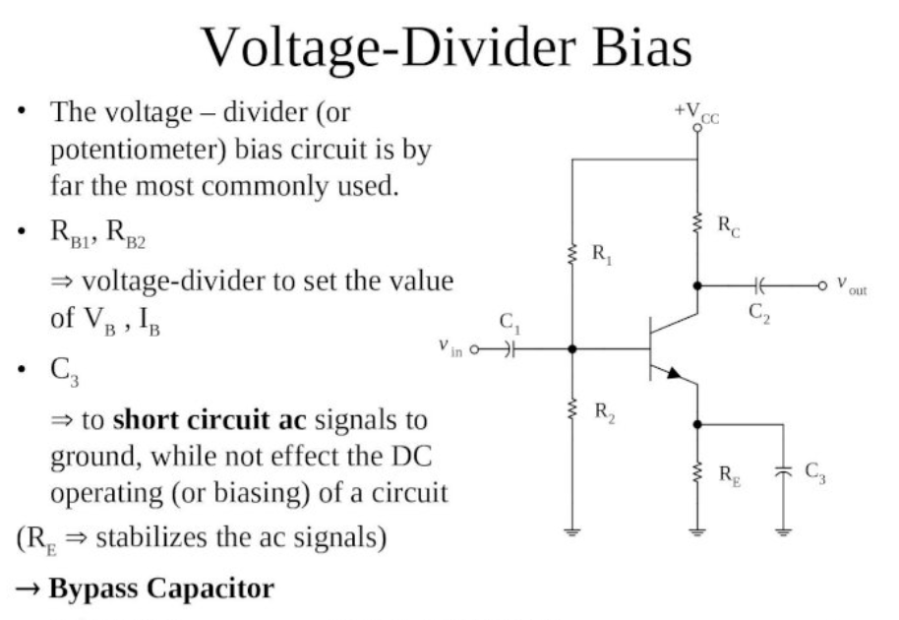

Slide 31
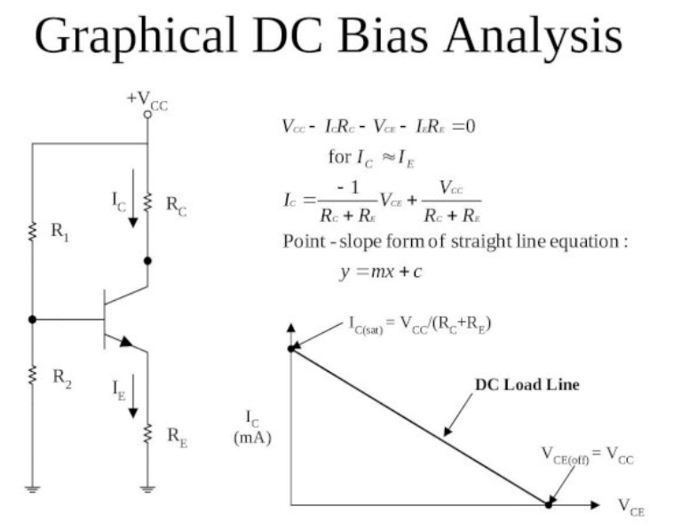

Slide 32
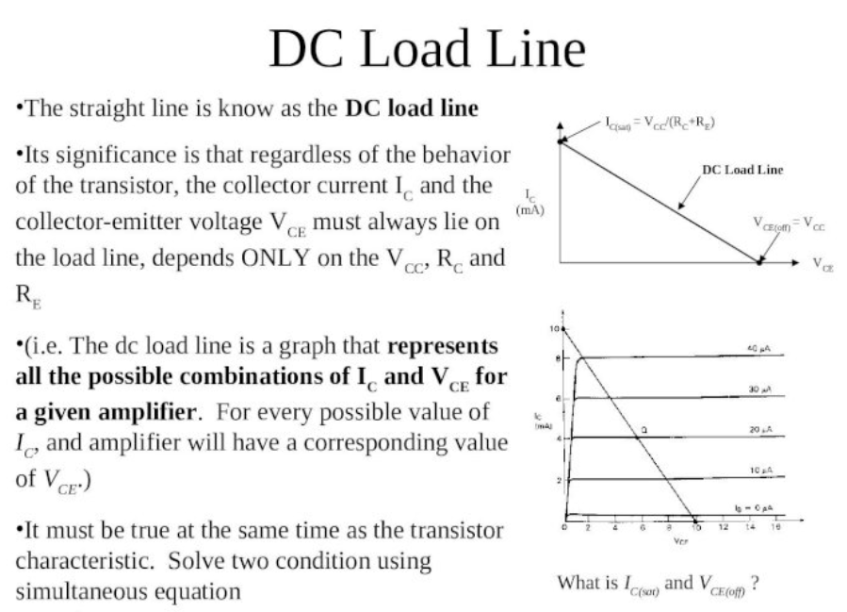

Slide 33
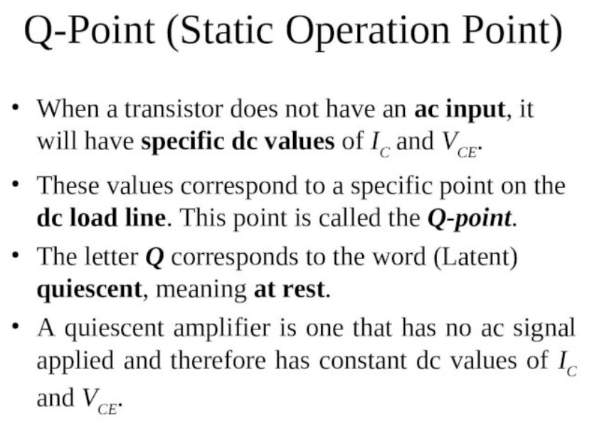

Slide 34
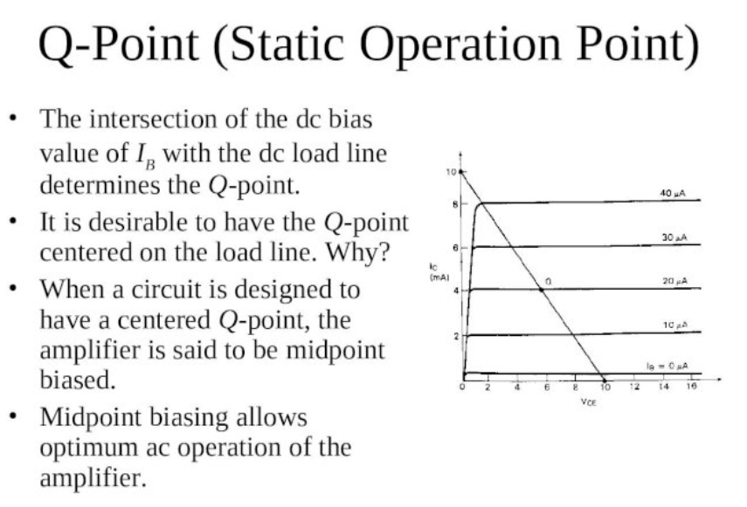

Slide 35
